Slide 1
Lecture 6
CS494 – Information System Audit and Control
11th March 2023

Slide 2
Recap – Governance and Management of IT
IT Governance
Information Security Governance
Information Security policy
IT operational procedures
IT Strategy

Slide 3
Which of the following is a determining factor in not maintaining customer data at an offshore location?
1. Time zone differences could prevent IT teams from interacting
2. The high cost of telecommunications lines
3. Privacy laws could prevent the flow of information across borders
4. Differences in software development standards

Slide 4
Which of the following is a major concern for an IS auditor when reviewing regulatory compliance of an organization?
A lack of documented processes for reporting offences
A lack of staff training regarding regulatory requirements
Junior staff are in charge of monitoring regulatory compliance
No list of applicable laws and regulations is maintained

Slide 5

Section 2 – IT Management

Slide 6
Governance vs Management?
What is governance?
Governance aims to provide direction for the attainment of business objectives. Direction is set through prioritization and decision-making.
Governance is concerned with setting goals, making strategic decisions, and providing oversight to ensure that an organization is achieving its objectives in a responsible and sustainable way
What is management?
Management aims to implement policies and procedures to achieve the goals and direction set by the governance body.
Management is responsible for implementing the decisions made by the governing body, managing resources effectively, and ensuring that the organization runs smoothly on a day-to-day basis

Slide 7
What is the objective of IT Management?
IT management refers to the monitoring, administration, and controlling of the IT assets of an organization.
One objective of IT management is to ensure that IT assets operate effectively and efficiently.
It aims to align the performance of those IT assets with the given business requirements.

Slide 8
What will we cover?
IT resource management.
IT service provider acquisition and management.
IT performance monitoring and reporting.
Quality assurance and quality management in IT.

Slide 9
IT Resource Management
Each enterprise faces the challenge of using its limited resources, including people and money, to achieve its goals and objectives.
Hiring is one of the most important aspects of IT management.
An organization’s hiring practices are important to ensure that the most effective and efficient employees are chosen and the organization is in compliance with legal recruitment requirements.

Slide 10
IT Resource Management – Other policies
Trainings
Keeping IT Professionals up to date.
Cross functional trainings to removal dependencies.
Training should also cover the organization's method of change management, crisis management, and business continuity structure.
Any infrastructure changes should be accompanied by appropriate training.
Scheduling and time reporting
With proper time and scheduling reporting, Management can determine whether staffing is adequate and whether the operation is running efficiently.
One of the scarcest resources in IT is time, and its proper reporting will definitely help to better manage this finite resource.

Slide 11
IT Resource Management – Other policies
Terms and Conditions for employment
Employee roles and responsibilities should be documented in a job description.
Employees should be aware of their roles and responsibilities. Doing this will improve the employee's understanding of the responsibility that they have for their position and reduces the chance of human error.
Standards for the performance evaluation of employees should be structured and quantified as far as possible.
Mandatory vacation policies should be implemented for each employee. During the absence of a dishonest employee, the majority of frauds are uncovered.
Mandatory job rotation policies should also be implemented. This expands the possibilities for monitoring the risk of fraudulent or malicious acts.

Slide 12
IT Resource Management – Other policies
Termination policies: Written termination policies should be established to provide clearly defined steps for employee separation.
Return of all devices, access keys, ID cards and badges—To prevent easy physical access
Deletion/revocation of assigned logon IDs and passwords—To prohibit system access
Notification—To alert appropriate staff and security personnel regarding the employee’s status change to “terminated”
Arrangement of the final pay routines—To remove the employee from active payroll files
Performance of a termination interview—To gather insight on the employee’s perception of management
Changes in job role and responsibilities, such as a transfer to a different department, may necessitate revocation and reissuance of system and work area access rights similar to termination procedures.

Slide 13


Slide 14
Why are these policies necessary?
Policies are necessary to ensure consistent actions in known situations.
Policies and procedures remove human dependencies.
Failure to implement policies can cause risks to emerge.

Slide 15
IT service provider acquisition and management
Outsourcing services to a third-party vendor is a widely accepted practice in today's world for two major reasons.
One of them is the tremendous savings in cost and the other is to avail the service of experts in the field.

Slide 16
IT service provider acquisition and management
Sourcing practices relate to the way in which the organization will obtain
the IT functions required to support the business.
Delivery of IT functions can be characterized as:
Insourced—Fully performed by the organization’s staff
Outsourced—Fully performed by the vendor’s staff
Hybrid—Performed by a mix of the organizations and the vendor’s staffs;
Onsite: Staff working onsite in the IT department
Offsite: Staff working from remote locations in the same geographical area
Offshore: Staff working from remote locations indifferent geographical areas

Slide 17
Evaluation criteria for outsourcing
Outsourcing of functions can be done if the following applies:
Functions that can be carried out by another party to the same level of quality or better, at the same price or lower, without increasing risk.
The following functions should not be outsourced:
The core functions of the organization – Why?
Roles that require specific expertise. Why?
Functions that cannot be outsourced due to contractual or regulatory constraints.

Slide 18
As an IS auditor
An IS auditor must understand the variety of vendor-provided services(e.g., commercial off-the-shelf HW/SW products, outsourced services to include cloud offerings, managed services) and the functional requirements these services are addressing.
Furthermore, an IS auditor needs to understand the vendor’s SLAs that are in place to address system/software operational and technical support requirements.
Additional considerations also include suppliers’ financial viability, licensing scalability and provisions for software escrow.

Slide 19
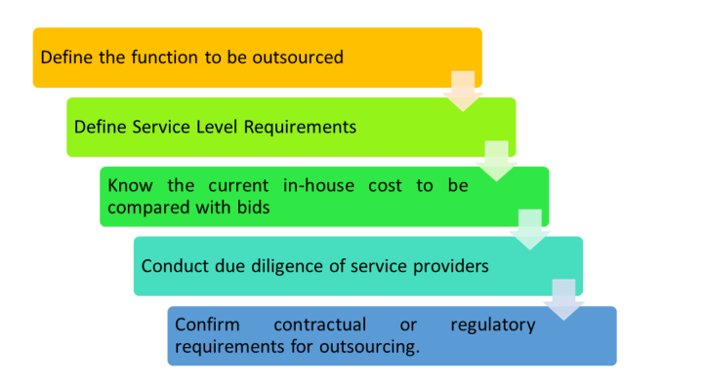
Outsourcing steps

Slide 20
Read
https://versionone.vc/never-ever-outsource-your-core/#:~:text=Outsourcing%20a%20core%20function%20may,as%20invested%20in%20your%20success.

Slide 21
Reducing risk in outsourcing decisions
A requirement for achievable output should be included in the SLA.
The use of an escrow arrangement for software assets.
The use of multiple suppliers helps to lower the risk of dependence.
Periodic reviews of performance.
Building a cross-functional contract management team.
Setting up appropriate controls for any anticipated contingencies

Slide 22
Provisions for an outsourcing contract
SLAs will serve as a monitoring tool for the outsourcing process They should contain, at the least, the following clauses:
Requirements for achievable output
Confidentiality, Integrity, and Availability (CIA) requirements for resources/systems/data
Confidentiality agreements to protect both parties
A right-to-audit clause
Business continuity and disaster recovery provisions
Intellectual property right

Slide 23
Role of IS Auditor
The following are some of the important functions of the IS auditor in monitoring outsourced activities:
To review contracts at the service level at periodic intervals
To review documented procedures and outcomes of the outsourcer's quality assurance programs
Periodic checks to ensure that the processes and procedures comply with outsourcer's quality standards

Slide 24
Outsourcing and 3rd party audit reports
Monitoring third-party performance and compliance with the SLA and other statutory requirements is important. Obtaining an independent third-party audit report will provide clarity regarding the state of affairs of service providers.
An audit report should cover any confidentiality, integrity, data,and system availability issues. Regulatory bodies mandate some third-party audits.
E.g. Unilever and HP

